Slide 1
Proposal Presentation: Greek Mythology
NLP & Information Retrieval – Final Group Project
Elyesa Duru 50251140 Dilara Alkanalka 50251145 Tim Leute 50251142 Hamidreza Rahimian 50251141

Slide 2
What is it about?
We analyze relationships between figures in Greek mythology.
The data is modeled as a graph – nodes = figures, edges = relationships.
Goal: Visualization and analysis of mythological networks (e.g., family, enmity, alliances, clusters etc.).

Slide 3
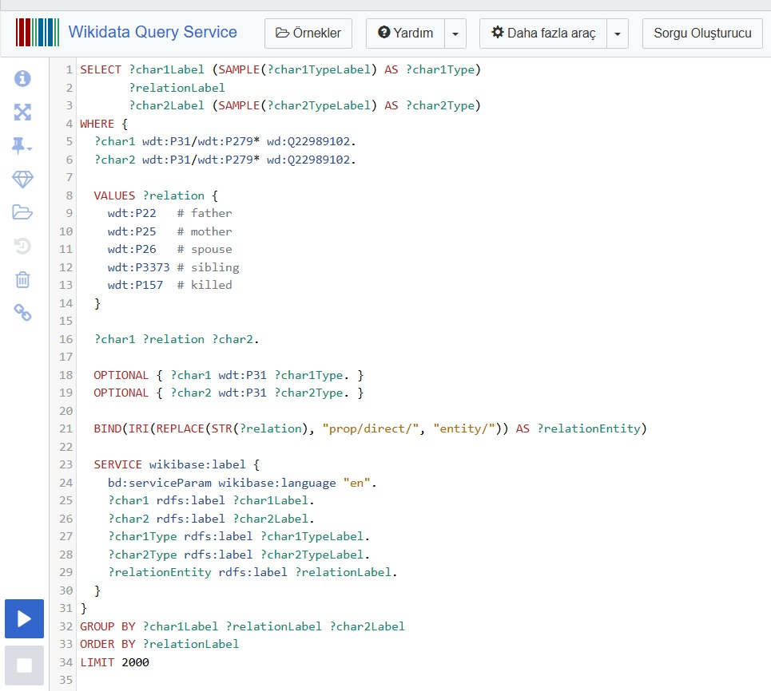
How did we get our data?
Dataset: Wikidata – Query Service using SPARQL on Greek mythology.
Wikidata items are identified by a „Q“ code.
Item „Zeus“ corresponds to Q34201
Properties are identified with a „p“ code.
Property „father“ corresponds to code „p22“

Slide 4
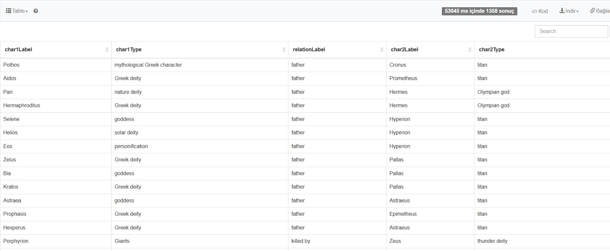
How did we get our data?
We gathered mythological characters and types(god/deity/titan etc.) with their relations to other characters
We imported this as a cvs file (1358 rows)

Slide 5
How did we design the Graph data?
We used python libraries like pandas loading and processing csv files
Networkx for create and manage directed graphs
And finally pyvis to visualize and turn the graph into a HTML page

Slide 6
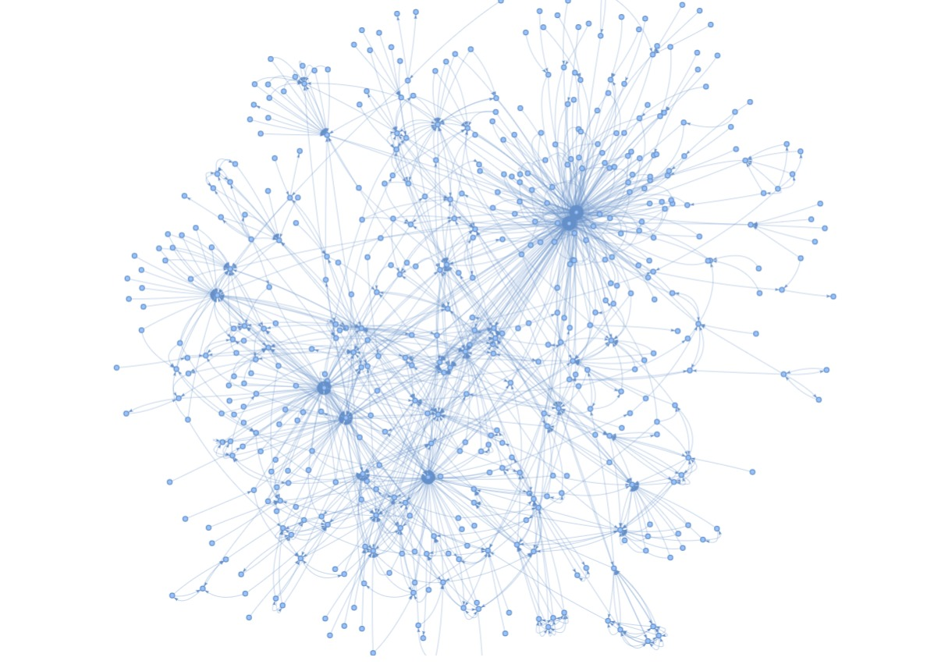

Slide 7
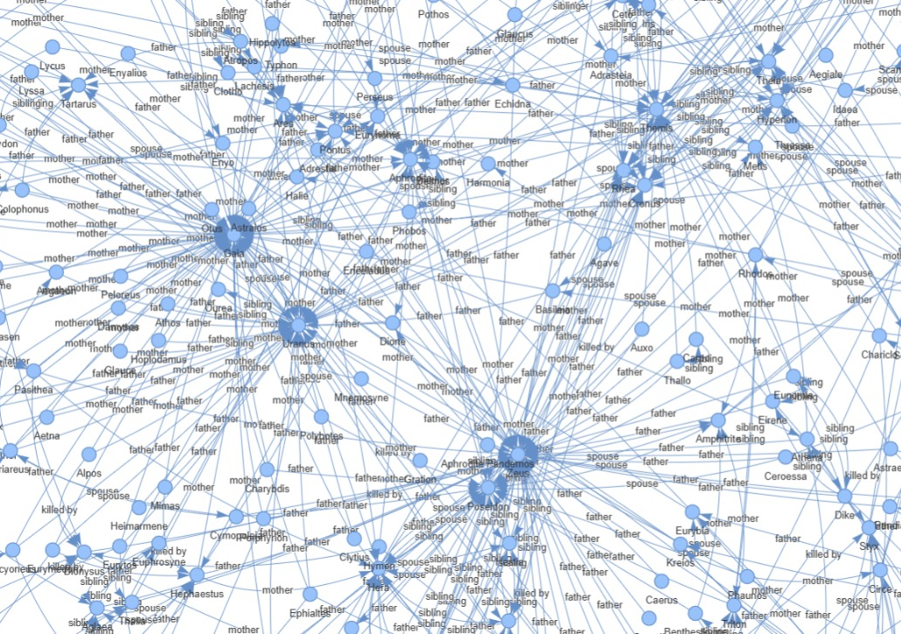

Slide 8
What can we do with the graph data?
Build and visualize a complex mythological network.
Explore social and familial structures.
Information Retrival System: Who are the children of Zeus?
Centrality Analysis PageRank: Which groups are tightly connected and what characters are more central?

Slide 9
How do we plan to implement the project?
Backend: Python using pandas & networkx.
Project flow: Graph → Queries → Visualization.
Goal: Interactive interface to explore Greek mythology as a network.

Slide 10
Teamwork & Task Distribution
Tasks chosen based on personal interests
Workload balanced across the team
Everyone contributed equally
Support provided when someone was overloaded
Tasks were adjusted flexibly as needed
We each chose tasks based on our interests and then balanced the workload evenly. Everyone contributed as a team
, and whenever someone was overworked or needed help, we supported each other and adjusted responsibilities.

Slide 11
References
Pastor-Sánchez, J., Kontopoulos, E., Saorín, T., Bebis, T., & Darányi, S. (2021). Greek Mythology as a Knowledge Graph: From Chaos to Zeus and Beyond. Semantic Web Journal. Retrieved from https://www.semantic-web-journal.net/system/files/swj2754.pdf
Wikidata SPARQL Query Service. (n.d.). Retrieved from https://query.wikidata.org/

